Slide 1

Chapter 11
How to create and use objects
Notes:
Session: Ghi số thứ tự session trong môn học
Session Name: ghi tên của session sẽ dạy

Slide 2
Objectives
Basic skills for working with objects
What you need to know about JavaScript prototypes
The Task Manager application
Advanced skills for working with objects
The Enhanced Task Manager application
Notes:
Mô tả nội dung mà học viên phải đạt được khi kết thúc môn học này

Slide 3
Basic skills for working with objects
Notes:
Session: Ghi số thứ tự session trong môn học
Session Name: ghi tên của session sẽ dạy

Slide 4
Introduction to Object in JavaScript
JavaScript permit you create an object base on the built-in class like Object, String, Number, Boolean, Date, Array, Function … They called Native Object Types.
There are two level hierarchy of object types. The top level consists of the Object object type. The next level consist types like String, Number, Boolean, Date, Array, Function…
Notes:
Can sua cho nay

Slide 5
How to create and use the native object types
The JavaScript hierarchy of the native object types
The syntax for creating a new object of a native type
var variableName = new ObjectType(arguments);
Example create a new object of the Date type
var today = new Date();
Object
String
Number
Boolean
Date
Array
Function

Slide 6
How to create and use the native object types - Example
Create a new object of a native type with literal values
Create a new object of the String type
var lastName = “Hopper”; //Same as new String(“Hopper”)
Create a new object of the Number type
var taxRate = .0875; //Same as new Number(.0875)
Create a new object of the Boolean type
var validFlag = true; //Same as new Boolean(true)
Create a new object of the Array type
var tasks = []; //Same as new Array()

Slide 7
How to create and use the native object types – Example (Cont.)
Create a new object of a native type with literal values
Create a new object of the Function type
var isValue = function(){…}; //Same as new Function(‘..’)
Create a new object of the Object type
var invoice = {};
Use the properties and methods of the native object types
Use the length property of a String object
length = lastName.length; //Same as lastName[“length”]
Use the toFixed method of a Number object
formattedRate = taxRate.toFixed(4);
//Same as taxRate[“toFixed”](4)l

Slide 8
How to create your own objects with object literals
Object literals it mean this object is created by a literal value.
When you create an object literal, you can add value properties by coding pairs of property names and values that are separated by colons.

Slide 9
How to create your own objects with object literals (cont.)
How to initialize a new object with properties and methods
Example 1: initialize a new object with one property
var invoice = { taxRate: 0.0875 };
Example 2: initialize a new object with one method
var invoice = {
getTotal: function(subtotal, salesTax){
return subtotal + salesTax;
}
};

Slide 10
How to create your own objects with object literals (cont.)
How to initialize a new object with properties and methods
Example 3: initialize a new object with properties and methods
var invoice = {
taxRate: 0.0875,
getSaleTax: function(subtotal){
return subtotal * this.taxRate;
},
getTotal: function(subtotal, salesTax){
return subtotal + this.getSaleTax(subtotal);
}
};

Slide 11
How to create your own objects with object literals (cont.)
Refer to the properties and methods of an object
alert(invoice.taxRate); //display 0.0875
var saleTax=invoice.getSalesTax(100); //saleTax=8.75
var invoiceTotal=invoice.getTotal(100);
//invoiceTotal=108.75
Nested objects and refer to nested properties and methods
How to nest one object within another
var invoice = {
terms:{
taxRate: 0.0875;
dueDays: 30
}
};
Refer to the properties and methods of nested object
alert(invoice.terms.taxRate); //Display 0.0875

Slide 12
How to extend or modify and object
Once an object created, you can add new properties and method to it. Also you can change the value of an existing property and change a method.
How to add properties and methods to an object
var invoice = {};
invoice.taxRate = 0.0875; //add a property
invoice.getSalesTax = function(subtotal){
return (subtotal * this.taxRate);
} //add a method

Slide 13
How to extend or modify and object (cont.)
How to modify the value of a property
invoice.taxRate = 0.095;
How to remove a property from an object
delete invoice.taxRate;
Two variables that refer to the same object
today = new Date();
now = today;

Slide 14
How to create your own object types with constructor functions
A constructor function(or constructor) is a special kind of function that creates an object type.
If you want to able to create multiple instances of yours owner object types, you can code constructor function for the object to be created.
You can code the methods for a constructor on the prototype object of the object type. That way, all the instances of the object type that are created by the constructor function share the same methods.

Slide 15
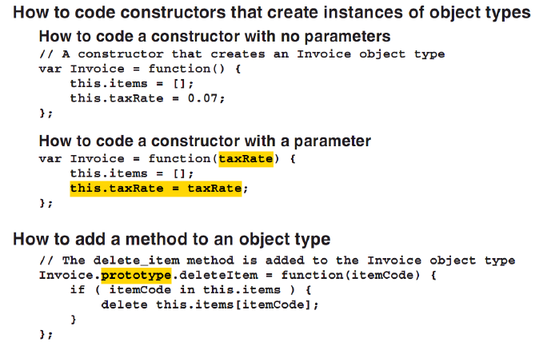
How to create your own object types with constructor functions (cont.)

Slide 16
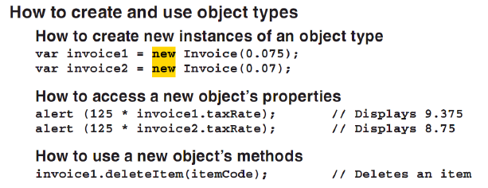
How to create your own object types with constructor functions (cont.)

Slide 17
What else you should know
About JavaScript prototypes
Notes:
Session: Ghi số thứ tự session trong môn học
Session Name: ghi tên của session sẽ dạy

Slide 18
How prototypes work
Many programming language use classes to create objects. This kind of language called class-based or classical.
JavaScript, uses prototype objects that are cloned to create new objects. This kind of language called classless or prototypal.
When you create a new object with an object literal, it is cloned from an object named Object.prototype

Slide 19
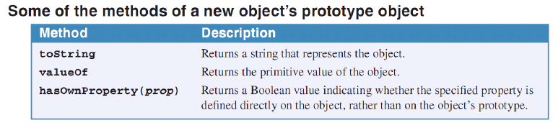
What else you should know about prototypes

Slide 20
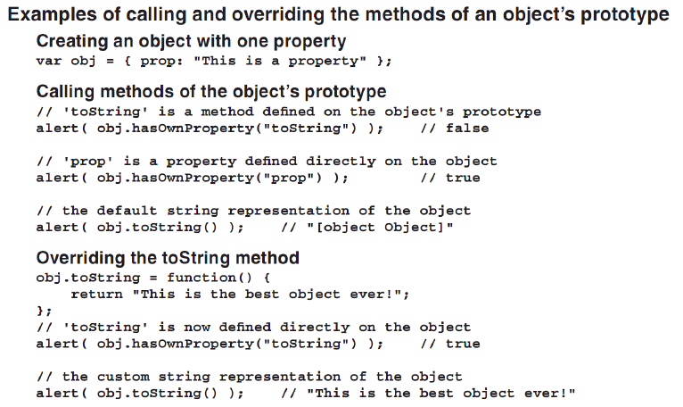
What else you should know about prototypes (cont.)

Slide 21
When and how to create custom prototypes
If you’re going to create multiple instances of an object that has methods, you should create the methods on the object’s prototype, not directly on the object.
This saves memory since each instance of an object refers to a prototype method rather than creating a duplicate method of its own.

Slide 22
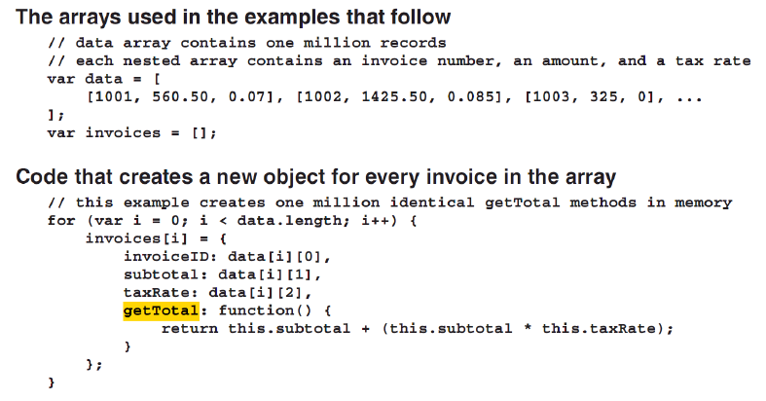
When and how to create custom prototypes (cont.)

Slide 23
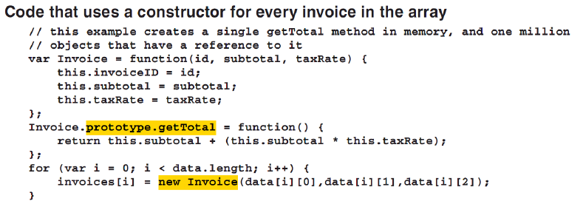
When and how to create custom prototypes (cont.)

Slide 24
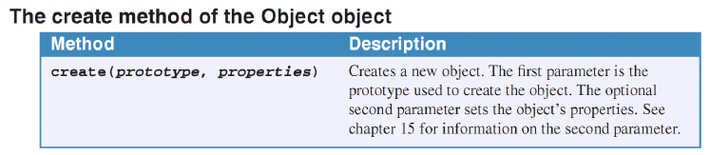
How to use the create method of the Object object
The create method of Object method lets you specify an object’s prototype.
Factory functions can be used to create custom prototype objects. These functions are similar constructor functions, but they don’t required new keyword.

Slide 25
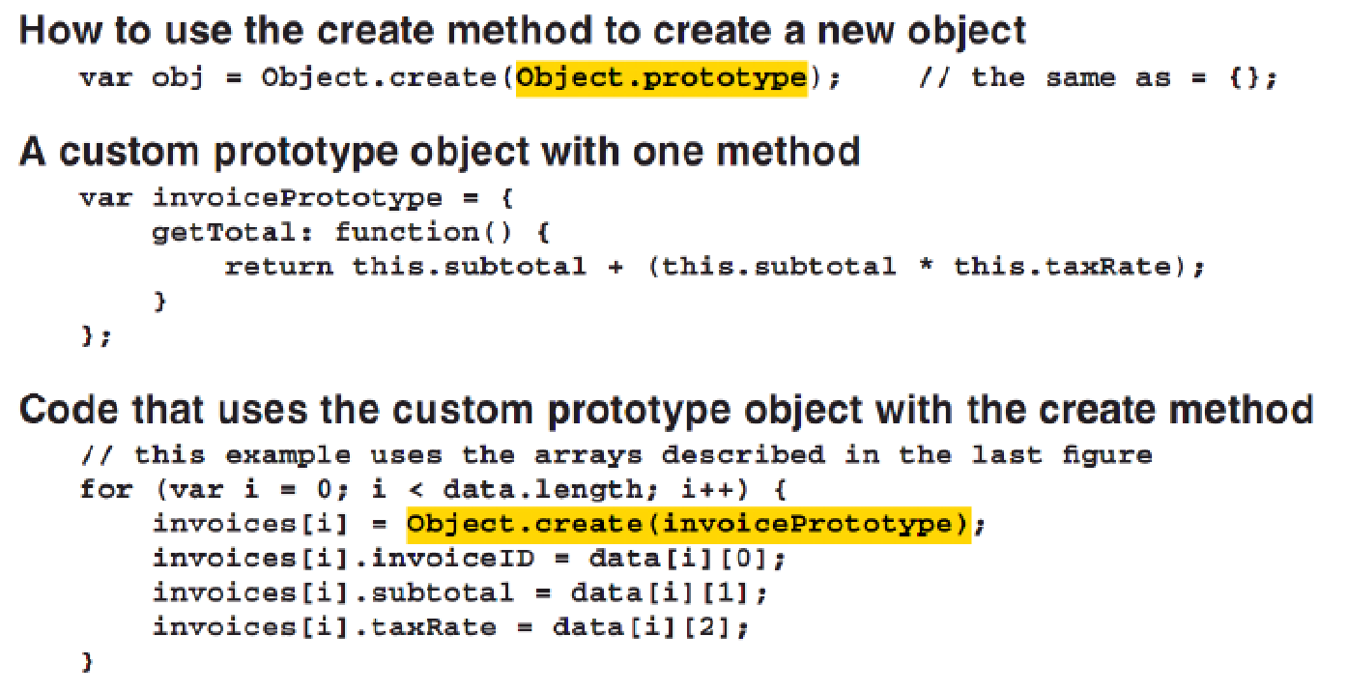
How to use the create method of the Object object (cont.)

Slide 26
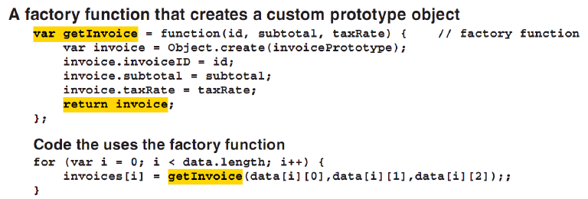
How to use the create method of the Object object (cont.)

Slide 27
The Task Manager application
Notes:
Session: Ghi số thứ tự session trong môn học
Session Name: ghi tên của session sẽ dạy

Slide 28
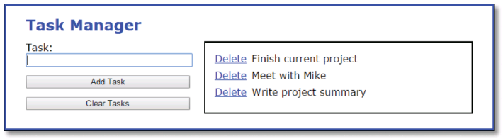
The Task Manager application
The User Interface

Slide 29
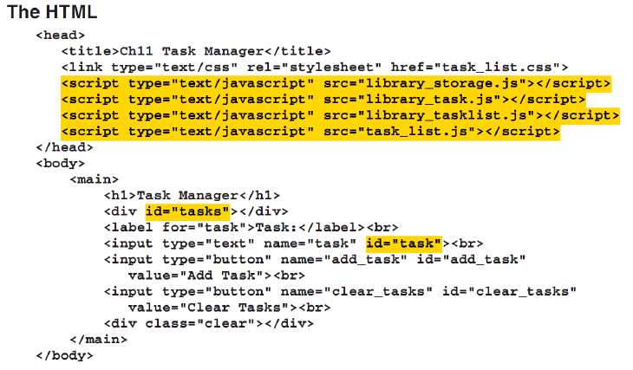
The Task Manager application

Slide 30
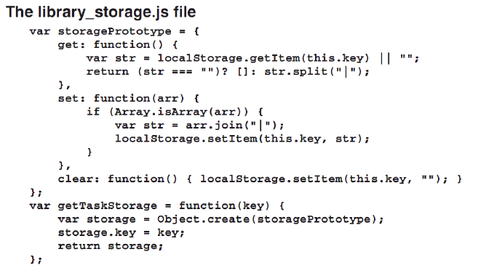
The Task Manager application

Slide 31
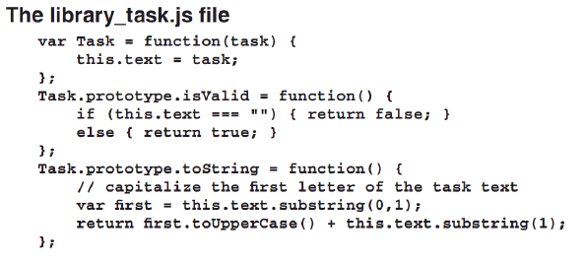
The Task Manager application

Slide 32
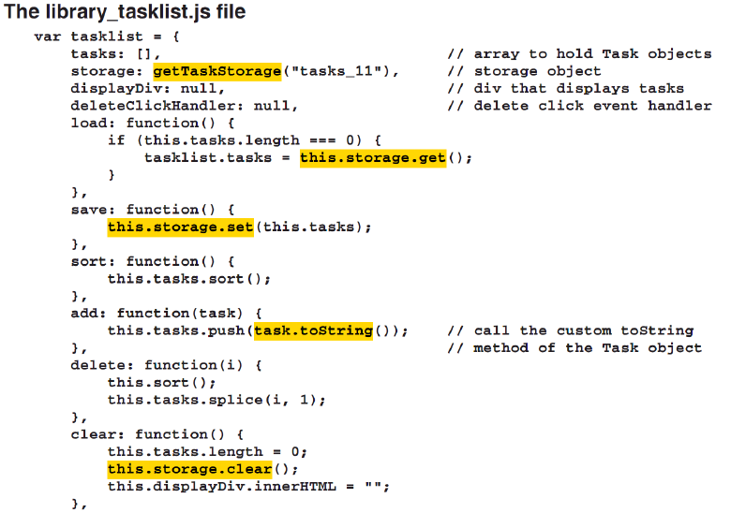
The Task Manager application

Slide 33
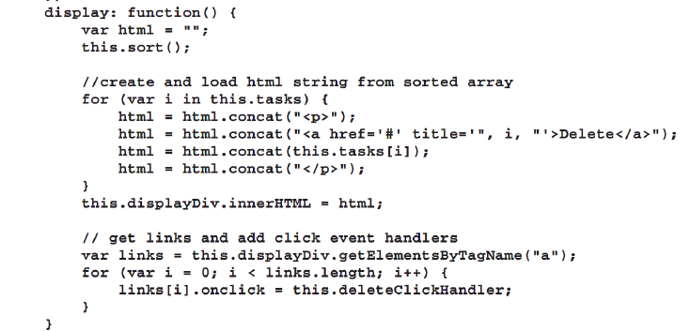
The Task Manager application

Slide 34
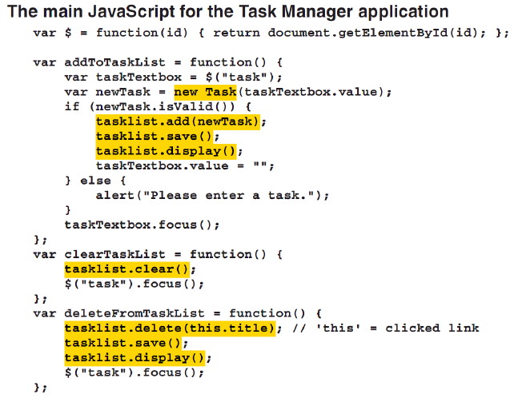
The Task Manager application

Slide 35
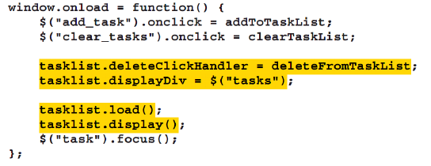
The Task Manager application

Slide 36
Advanced skills for
working with objects
Notes:
Session: Ghi số thứ tự session trong môn học
Session Name: ghi tên của session sẽ dạy

Slide 37
How to inherit methods from another object
Inheritance lets you share base functionality among several object.
This let you create a base object with common methods and then extend it with more specialized methods.
You can inherit the methods of an object by using constructor or using the Object.create() method.

Slide 38
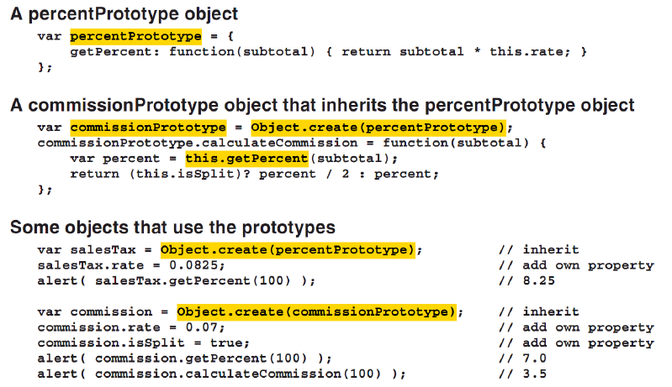
How to inherit methods from another object with Object.create methods

Slide 39
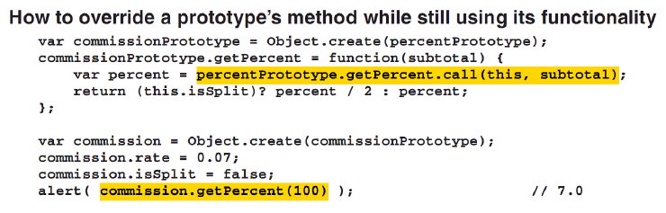
How to inherit methods from another object with Object.create methods (cont.)

Slide 40
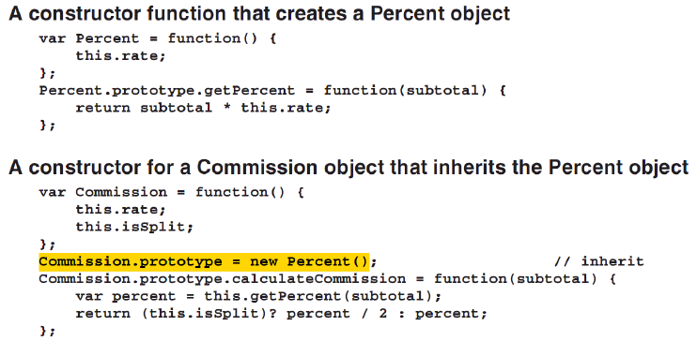
How to inherited methods from another object with constructors
To inherited the methods of an object created by a constructor, set the prototype object of the child object to an instance of the parent object.

Slide 41
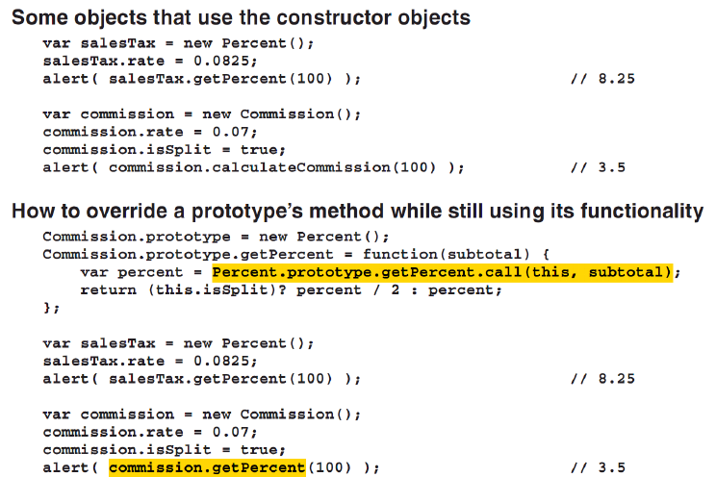
How to inherited methods from another object with constructors (cont.)

Slide 42
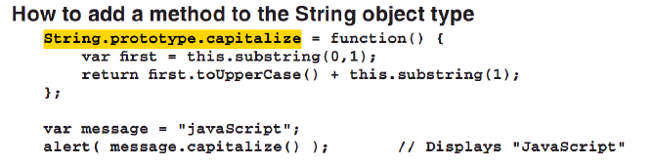
How to add methods to the native object types
To add a method to a native object type, you add the new object to its prototype object.
Then all objects of that type, including existing object, will inherit the new object.

Slide 43
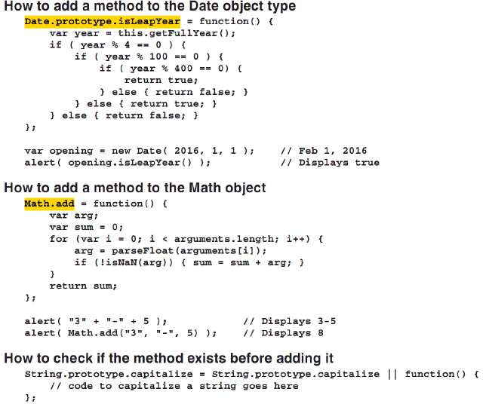

Slide 44
How to create cascading methods
A cascading method is a method of an object that can be chained with another methods.
Example:
tasklist.load().display( $(“tasks”));
To do that, the method must return a reference to the original object by using the this keyword.

Slide 45
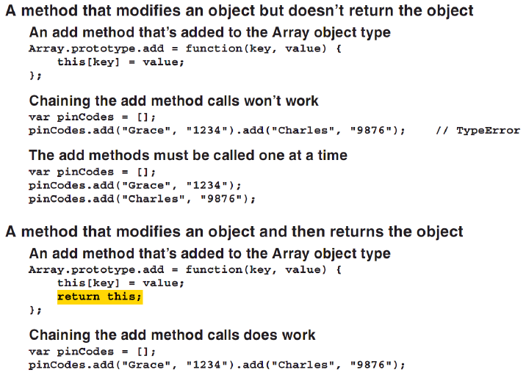
How to create cascading methods (cont.)

Slide 46
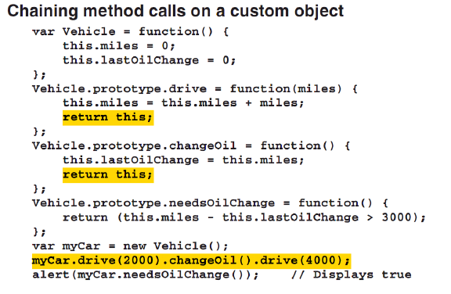
How to create cascading methods (cont.)

Slide 47
How to use in, instanceof and typeof operators
The in operator return true if an object have the named property.
The instanceof operator return true, if an object is an instance of the special object type.
The typeof operator lets you determine the type of a variables.

Slide 48
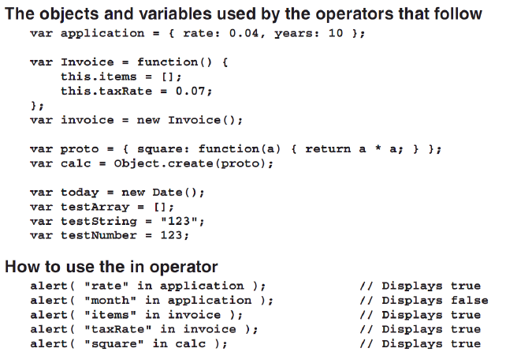
How to use in, instanceof and typeof operators (cont.)

Slide 49
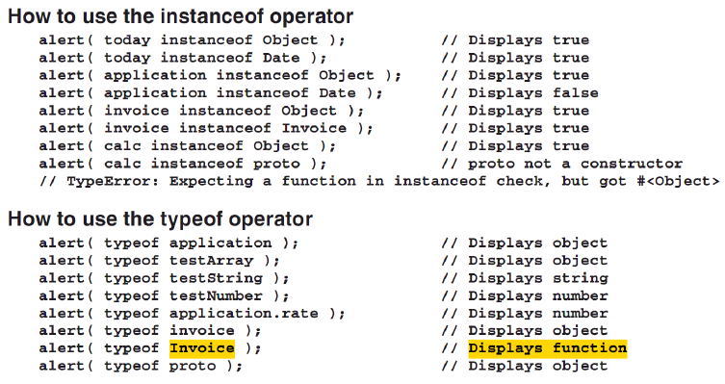
How to use in, instanceof and typeof operators (cont.)

Slide 50
The Enhanced Task Manager application
Notes:
Session: Ghi số thứ tự session trong môn học
Session Name: ghi tên của session sẽ dạy

Slide 51
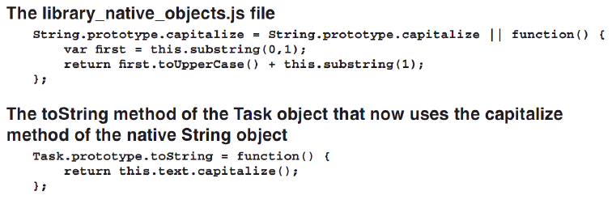
The Enhanced Task Manager application

Slide 52
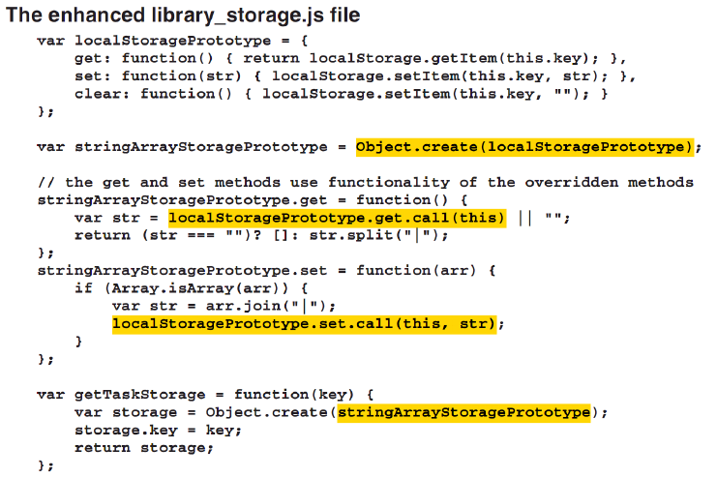
The Enhanced Task Manager application

Slide 53
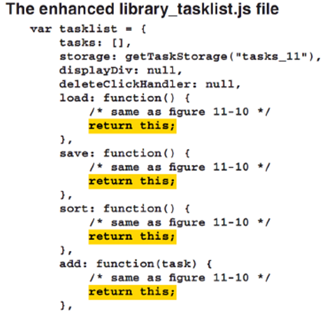
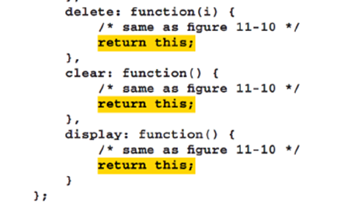

Slide 54
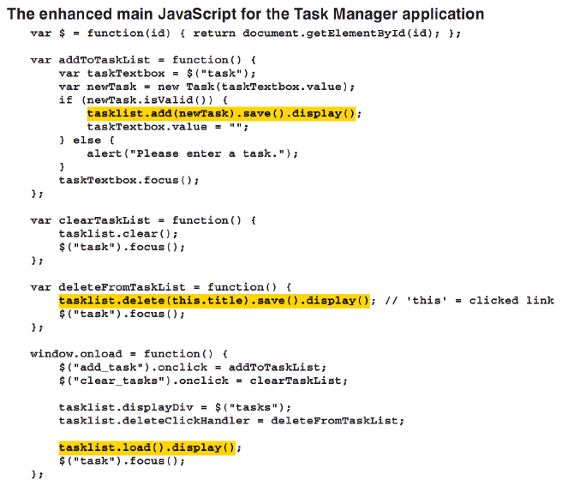

Slide 55
Summary
JavaScript permit you create an object base on the built-in class like Object, String, Number, Boolean, Date, Array, Function … They called Native Object Types.
There are two level hierarchy of object types. The top level consists of the Object object type. The next level consist types like String, Number, Boolean, Date, Array, Function…
Object literals it mean this object is created by a literal value.
A constructor function(or constructor) is a special kind of function that creates an object type.
Notes:
Tóm tắt lại nội dung đã học

Slide 56
Summary
Many programming language use classes to create objects. This kind of language called class-based or classical.
JavaScript, uses prototype objects that are cloned to create new objects. This kind of language called classless or prototypal.
Inheritance lets you share base functionality among several object.
This let you create a base object with common methods and then extend it with more specialized methods.
You can inherit the methods of an object by using constructor or using the Object.create() method.
Notes:
Tóm tắt lại nội dung đã học

Slide 57
The End.

